Slide 1
View Object
(Section 1)

Slide 2
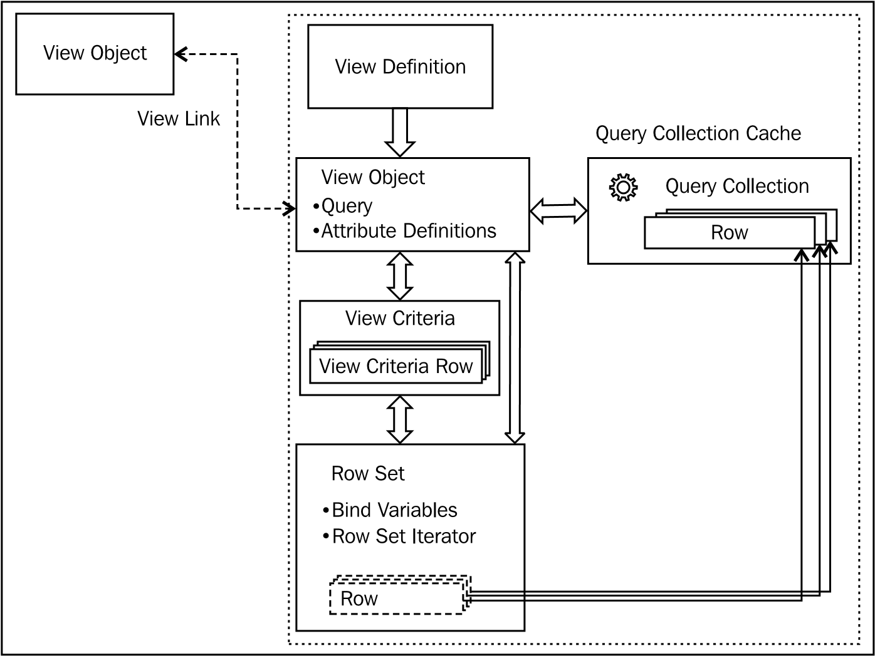
Ingredients of a view object

Slide 3
Creating a declarative SQL mode view object
A declarative SQL mode view object will formulate its SQL statements at runtime based on the columns selected by the client for display. A declarative view object will simplify the query in two steps:
Removing the attributes in the SELECT list, which are not selected by the client
Removing tables in the FROM clause—if the pruning rules allow this

Slide 4
Rules of declarative SQL mode view object
Only entity-based view objects can be turned into declarative mode
Primary key attributes will always be in the SQL SELECT
Attributes, which need to be conditionally excluded from the SQL SELECT statement, should have Selected in the Query property set to false.
If an attribute is configured to depend upon other attributes, the driving attributes will be automatically selected whenever the dependent attribute is part of the selected attribute list.

Slide 5
Rules of declarative SQL mode view object
If a view object is based on multiple entity object the following things can be true:
The table corresponding to the primary entity usage will always be part of the join in the query
The table corresponding to secondary (non-primary) entity usage will be part of the join query, if it has at least one attribute in the selected list
The primary key attribute of a table corresponding to an entity usage will be automatically added to the selected list, if that table is part of the join query
The table corresponding to an entity usage will be automatically added to the join query, if an applied view criteria or a sort criteria clause refers an attribute from this entity usage

Slide 6
Inheritance hierarchies in view objects with nonpolymorphic entity usage
If the view objects that you have selected as a base for extending do not contain any polymorphic entity usage, the extended view object will have the following properties:
The new extended view object will inherit all the metadata definitions from the base view object, which includes attribute definitions, query, view criteria, bind variables, view accessor , and view link definitions.
The extended view object can optionally override the query and bind variable values, and add extra bind variables, view criteria, and view links.
Overriding the attributes and methods from the Java implementations of an extended view object follows the rules in Java language.

Slide 7
Inheritance hierarchies in view objects with polymorphic entity usage
A polymorphic view object refers to a view object, which has the ability to process properties and functions differently by dynamically linking the matching entity object usages in the hierarchy based on the polymorphic discriminator value.
When you use a polymorphic view object to create a row, the framework will delegate the call to create a row for the corresponding entity usage, which is evaluated based on the value set for the polymorphic discriminator attribute.

Slide 8
Inheritance hierarchies in view objects with polymorphic entity usage
If you call createAndInitRow() with discriminator attribute the framework will resolve the underlying entity object as SalesEmployeeEO and will invoke the create(AttributeList nameValuePair) method on it.
Row row=null;
NameValuePairs nvp=null;
MarketingEmployeeListVOImpl vo =(MarketingEmployeeListVOImpl)
getMarketingEmployeeList();
nvp = new NameValuePairs();
nvp.setAttribute("DepartmentId", "90");
//VO delegates the createAndInitRow() call to SalesEmployeeExEO as //DepartmentId=90
row=vo.createAndInitRow(nvp);

Slide 9
Specifying the query mode for a view object
A view object's query mode selects the datasource that will be used to populate the row set. The query modes for a view object are as follows:
Scan database tables: In this mode, the query is fired against the database. This is the default query mode for a view object.
Scan view rows: In this mode, the view object queries the rows that are already present in the query collection.
Scan entity cache: This mode is applicable only to entity-based view objects. In this mode, the rows in the entity cache are queried to build the row set.
You cannot use expert mode view objects in the in-memory query mode such as scan the view rows or scan the entity cache. This is because the framework does not replicate all the search capabilities from the database in the middle tier, which is not efficient as well.

Slide 10
Specifying the query mode for a view object
//1. ViewObject.QUERY_MODE_SCAN_DATABASE_TABLES
//2. ViewObject.QUERY_MODE_SCAN_VIEW_ROWS
//3. ViewObject.QUERY_MODE_SCAN_ENTITY_ROWS
ViewObject vo = findViewObject("EmployeeDetails");
vo.setQueryMode(ViewObject.QUERY_MODE_SCAN_ENTITY_ROWS);
vo.executeQuery();
You can either use the query modes individually on a view object or combine multiple query modes, using Java logical operator (mode1 | mode2).
Runtime uses the following execution order when the view object has multiple query modes set:
Scan through view rows (if specified)
Scan through entity cache (if specified)
Scan through database tables (if specified)

Slide 11
Appending the WHERE clause at runtime
To append the WHERE clause at runtime, call setWhereClause() on the view object. If the WHERE clause contains bind variables that have been added at runtime, call defineNamedWhereClauseParam to define the same. Here is an example:
vo.setWhereClause("FirstName = :bindVarFirstName");
vo.defineNamedWhereClauseParam("bindVarFirstName", null, null);
vo.setNamedWhereClauseParam("bindVarFirstName","Tom");
vo.executeQuery();

Slide 12
Changing the query of a view object at runtime
A view object will allow you to modify the design-time SQL query at runtime. If you are modifying the query of the view object, which is bound to some non-dynamic UI elements on a web page, make sure the new query that you set for the view object returns the same attribute definitions as in the original case
voImpl.setFullSqlMode(voImpl.FULLSQL_MODE_AUGMENTATION);
RowSet[] rowSets = voImpl.getRowSets();
if (rowSets != null){
for (RowSet rowSet : rowSets) {
rowSet.closeRowSet(); }
}
voImpl.setWhereClause(null);
voImpl.setWhereClauseParams(null);
voImpl.setQuery(newQueryString);

Slide 13
Programmatically sorting view object rows
To sort the rows in a view object at runtime, you can use the following APIs depending upon whether the attribute is a transient type or persistent:
Use the setSortBy() method to sort transient attributes, which will take attribute names with the desc or asc clause.
vo.setSortBy("FullName desc");
vo.executeQuery();
Use the setOrderByClause() method to sort columns from the database table (persistent attributes).
vo.setOrderByClause("EmployeeEO.FIRST_NAME ASC");
vo.executeQuery();

